Slide 1
19CSE452
SEMANTIC WEB
3 0 0 3
Meta Data
RDF
Graph Representation of RDF
Semantic Net

Slide 2
Metadata
Metadata are data that give additional information about other data.
For example, the title of a web page or the name of its creator can be metadata about the web page.
W3C language (standard) for describing metadata for the Web is RDF (Resource Description Framework)
which is rather a data model that allows the declaration of
additional information (or properties) about existing web resources,
e.g. Web pages, Web services, etc.

Slide 3
Resource Description Framework
RDF stands for:
Resource: Everything that can have a unique identifier (URI), e.g. pages, places, people, dogs, products...
Description: attributes, features, and relations of the resources
Framework: model, languages and syntaxes for these descriptions
RDF was published as a W3C recommendation in 1999.
RDF was originally introduced as a data model for metadata.
RDF was generalised to cover knowledge of all kinds.

Slide 4
Resource Description Framework
Main construct of RDF is the statement, which asserts a property value for a resource
is composed by a subject (the resource for which the property value is asserted for), a predicate (which is the name of the property) and an object (which is the value of the property for the specific resource subject).
An example of an RDF statement is the following:
web page http://ex.com/~jsmith is owned by John Smith
where the subject of the statement is http://ex.com/~jsmith, the predicate is owned by and John Smith is the object.

Slide 5
Graph RDF Representation
web page http://ex.com/~jsmith is owned by John Smith
Fig. shows the representation of an RDF statement as a directed, labelled graph, where the subject and the object are nodes and the predicate is an arc, directed from the subject node to the object node.

Slide 6
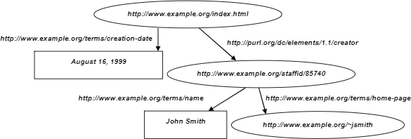
Graph RDF Representation – Semantic Net

Slide 7
RDF Representation
The subject of a statement is always a resource, whereas the object can either be a literal value (e.g. a date, a number, or a string) or another resource.
Predicates are also considered as resources.
Resources are uniquely identified in the web with URIs (Uniform Resource Identifiers), even if they do not correspond to accessible web resources.
For example, John Smith can be considered as a web resource and have a URI associated with him.
Furthermore, the predicate is owned by can be considered as a term declared in a specific web document, it can also be represented by a URI.
The use of URIs offers clarity of attribution and referencing in the vast space of the web.
If we replace the predicate and the object with URIs, the previous statement becomes: http://ex.com/~jsmith http://terms.org/owned_by http://ex.com/staff.html#id1734

Slide 8
RDF Representation
Same web document consists of several smaller components or resources, or it declares several terms.
Full URI of a resource consists of a common prefix (the address of the
containing document) and an internal local name (or address#localName.
Namespaces are aliases for those address prefixes
They are commonly used to collect resources within the same context and can also be used to shorten the URIs of the resources, in the form namespace:localName.
anchor) in the form
For example, if we assign http://ex.com/staff.html and the the above statement becomes:
the prefix
prefix term to
staff to the URI the URI http://terms.org/
staff:id1734 terms:owner http://ex.com/~jsmith

Slide 9
RDF Structure
RDF is located on top of XML in the Semantic Web therefore RDF has XML syntax. However, this syntax is used for tool compatibility reasons, since the two languages have completely different semantics.
RDF can be represented in three different ways:
RDF Graph
RDF/XML
RDF/Turtle format
For example, RDF statement example in RDF/XML syntax is represented as follows:
<rdf:RDF xmlns:rdf=‘http://www.w3.org/...rdf-syntax-ns#’ xmlns:term="http://terms.org/">
<rdf:Description rdf:about="http://ex.com/~jsmith/">
<term:owned_by rdf:resource="http://ex.com/staff.html#id1734"/>
</rdf:Description>
</rdf:RDF>

Slide 10
<?xml version="1.0"?> <rdf:RDF xmlns:rdf="http://www.w3.org/1999/02/22-rdf-syntax-ns#" xmlns:si="https://www.w3schools.com/rdf/"> <rdf:Description rdf:about="https://www.w3schools.com"> <si:title>W3Schools</si:title> <si:author>Jan Egil Refsnes</si:author> </rdf:Description> </rdf:RDF>

Slide 11
Title | Artist | Country | Company | Price | Year
Empire Burlesque | Bob Dylan | USA | Columbia | 10.90 | 1985
Hide your heart | Bonnie Tyler | UK | CBS Records | 9.90

Slide 12
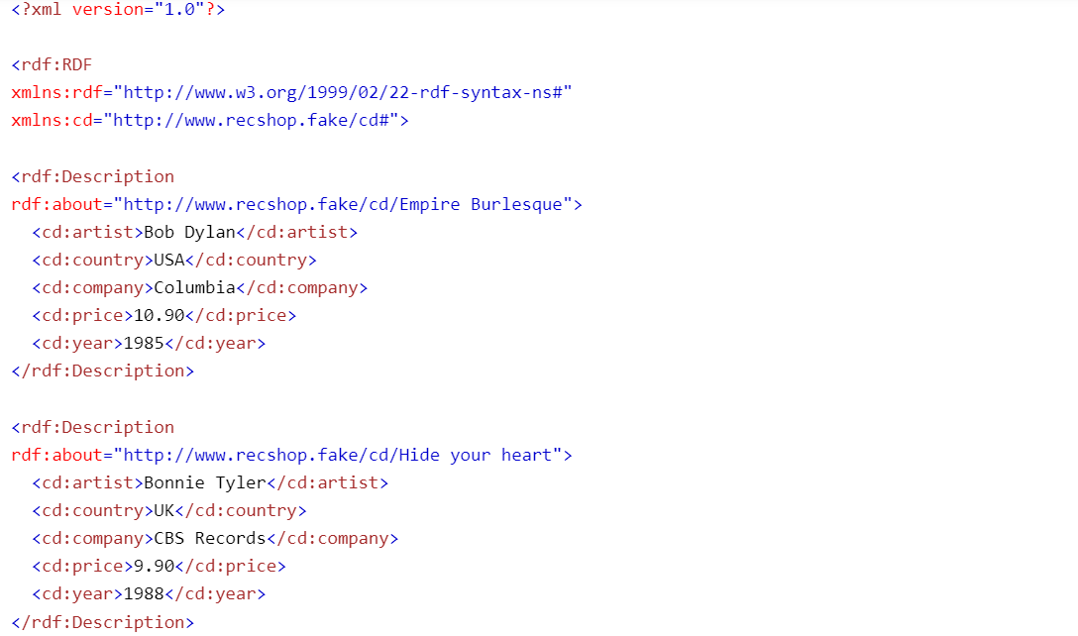

Slide 13
RDF and XML difference
The main difference between RDF and XML is that
XML does not define the meaning of data, except when
there is a commonly agreed meaning between exchanging
<faculty>
<lecturer>
<name>John Smith</name>
<teaches>
<course>
<name>Algorithms</name>
<student> aem153</student>
<student>aem202</student>
</course>
</teaches>
</lecturer>
</faculty>
parties. RDF has a formally defined way to interpret statements.
No standard interpretation of the tag nesting mechanism of XML. The nesting of tag A in B can be interpreted in three different ways:
Α is a part of Β
Α is a subset of Β
Α is a property of Β
In XML shown - nesting of lecturer tag inside faculty tag is actually a subset relation, nesting of name tag inside either
lecturer or course tags is a property relation, and finally, nesting of student tags inside course tag implies that students are part of a course. In RDF and RDF Schema there is a standard interpretation for all those relations

Slide 14
RDF Representation in XML Format
<rdf:RDF
xmlns:rdfs=“http://www.w3.org/2000/01/rdf-schema#” xmlns:org=“http://www.w3.org/ns/org#” xmlns:locn=“http://www.w3.org/ns/locn#” >
<org:Organization rdf:about=“http://publications.europa.eu/resource/authority/corporate-body/PUBL”>
<rdfs:label> “Publications Office”< /rdfs:label>
<org:hasSite rdf:resource=“http://example.com/site/1234”/>
</org:Organization>
<locn:Address rdf:about=“http://example.com/site/1234”/>
<locn:fullAddress>”2, rue Mercier, 2985 Luxembourg, LUXEMBOURG”
</locn:fullAddress>
</locn:Address>
</rdf:RDF>

Slide 15
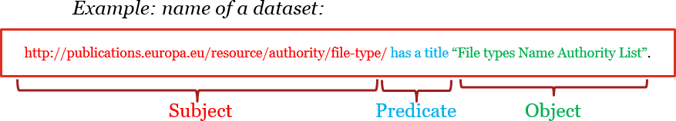
RDF Representation
RDF is a general syntax for representing data on the Web.
Every piece of information expressed in RDF is represented as a triple:
Subject – a resource, which may be identified with a URI.
Predicate – a URI-identified reused specification of the relationship.
Object – a resource or literal to which the subject is related.

Slide 16
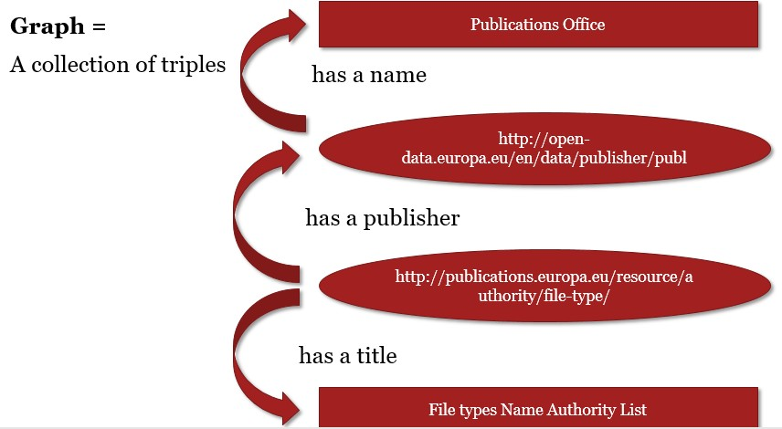

Slide 17
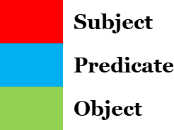
RDF / XML
<rdf:RDF
xmlns:rdfs=“http://www.w3.org/2000/01/rdf-schema#”
xmlns:dcat=“http://www.w3.org/TR/vocab-dcat/“ Description of prefixes
xmlns:dct=“http://purl.org/dc/terms/”
<dcat:Dataset rdf:about=“http://publications.europa.eu/resource/authority/file-type/”>
<dct:title> “File types Name Authority List”< /dct:title>
<dc:publisher rdf:resource=“http://open-data.europa.eu/en/data/publisher/publ”/>
</dcat:Dataset>
<dct:Publisher rdf:about=“http://open-data.europa.eu/en/data/publisher/publ”/>
<dct:title>”Publications Office”</dct:title>
</dct:Publisher> Description of Triples
</rdf:RDF>
RDF/XML is currently the only syntax that is standardised by W3C.

Slide 18
RDF / Turtle Syntax
@prefix dcat: <http://www.w3.org/TR/vocab-dcat/> @prefix dct: <http://purl.org/dc/terms/.
Description of prefixes
< http://publications.europa.eu/resource/authority/file-type/> a <dcat:Dataset> ;
dct:title “File types Name Authority List“;
dct:publisher <http://open-data.europa.eu/en/data/publisher/publ> .
<http://open-data.europa.eu/en/data/publisher/publ>
a <dct:publisher> ;
dct:title “Publications Office” .
Description of Triples
Turtle will be standardised in RDF 1.1.

Slide 19
How to represent data in RDF -
Classes, properties and vocabularies
RDF Vocabulary
“A vocabulary is a data model comprising classes, properties and relationships
which can be used for describing your data and metadata.”
RDF Vocabularies are sets of terms used to describe things.
A term is either a class or a property. Object type properties (relationships) Data type properties (attributes)

Slide 20
What are classes, relationships and properties?
Class. A construct that represents things in the real and/or information world,
e.g. a person, an organisation, a concepts such as “health” or “freedom”.
Relationship. A link between two classes; for the link between a document and the organisation that published it (i.e. organisation publishes document), or the link between a map and the geographic region it depicts (i.e. map depicts geographic region). In RDF relationships are encoded as object type properties.
Property. A characteristic of a class in a particular dimension such as the legal name of an organisation or the date and time that an observation was made.

Slide 21
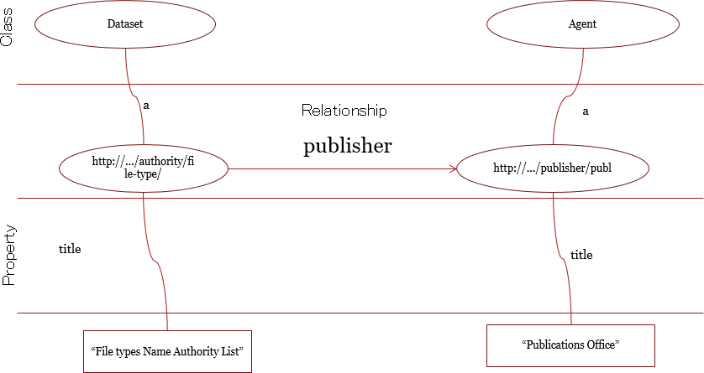

Slide 22
Reusing RDF vocabularies
Reuse greatly aids interoperability of your data.
Use of dcterms:created, for example, the value for which should be a data typed date such as 2013-02-21^^xsd:date, is immediately process able by many machines. If your schema encourages data publishers to use a different term and date format, such as ex:date "21 February 2013" – data published using your schema will require further processing to make it the same as everyone else's.
Reuse adds credibility to your schema.
It shows that it has been published with care and professionalism, again, this
promotes its reuse.
Reuse is easier and cheaper.
Reusing classes and properties from well defined and properly hosted vocabularies avoids your having to replicate that effort.

Slide 23
RDF vocabularies
rdf:Resource
It is an attribute of a property element. Resource is an entity described with meta data.
rdf:Property
Properties are special type of resource used as predicate of triples.
rdf:subPropertyOf
Applies to properties and must be interpreted as subset relation between the relations they denote.
rdfs:Class, rdfs:type, rdfs:subClassOf
Classes denotes to a set of resources by the means of the property rdf:type -
instrances.
Its hierarchy is denoted with rdfs:subClassOf
rdfs:domain and rdfs:range
rdfs:domain : is a property used to indicate that a particular property applies toa
designed class.
rdfs:range : is a property used to indicate that the values of a particular property are instances of designated class.

Slide 24
RDF vocabularies
rdfs:Literal
Denoting a set of literal, is declared as a class. Mainly used in the range of properties.
rdfs:Container
Are collections of resources. Modelled by instance of one the three subclasses:
rdf:Bag, rdf:Seq, rdf:Alt.
rdf:_1, rdf:_2…
rdfs:Label, rdfs:comment.
Membership is modelled automatically as
Used for human readability text with longer description.

